Slide 1

Real-time geospatial Data processor and visualizer
Client: Werner Raath (CSIR)

Slide 2

Overview of system
NASA
OpenWeather Map
USGS
Twitter
Geospatial Data Processor & Visualizer

Slide 3
Changes from previous demo and issues
Weather Feature
Disaster Feature
Data Clustering
Added Time Queries
Unit Tests

Slide 4
Wow!! Factor
Holidays
3 times a week (Mon, Wed, Fri) from 11 – 3 pm
Mainly doing research
During semester
3 times a week (Mon, Tues, Thurs) for an hour or more
Other than the abovementioned times, meetings are held on Slack and Whatsapp.

Slide 5
burn-down chart

Slide 6
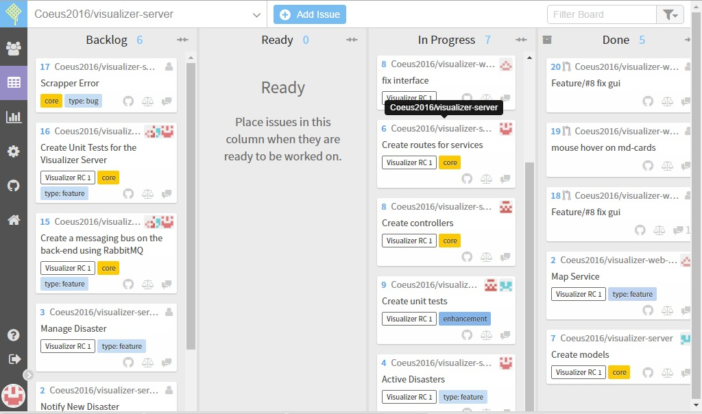
Scrum board

Slide 7
Demo

